Slide 2

What is a ‘fair test’?

Slide 3
Why is exercise good for our bodies?

Slide 4
How can we look after our teeth?

Slide 5
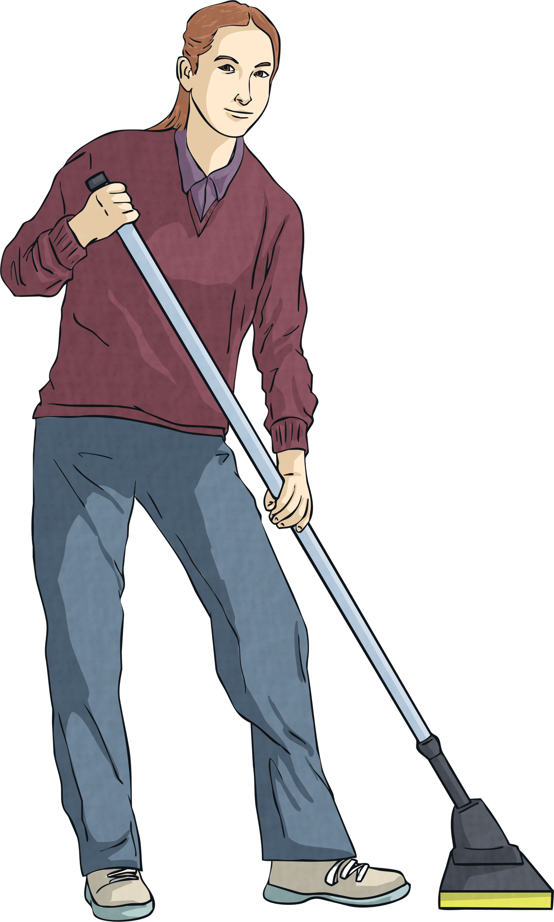
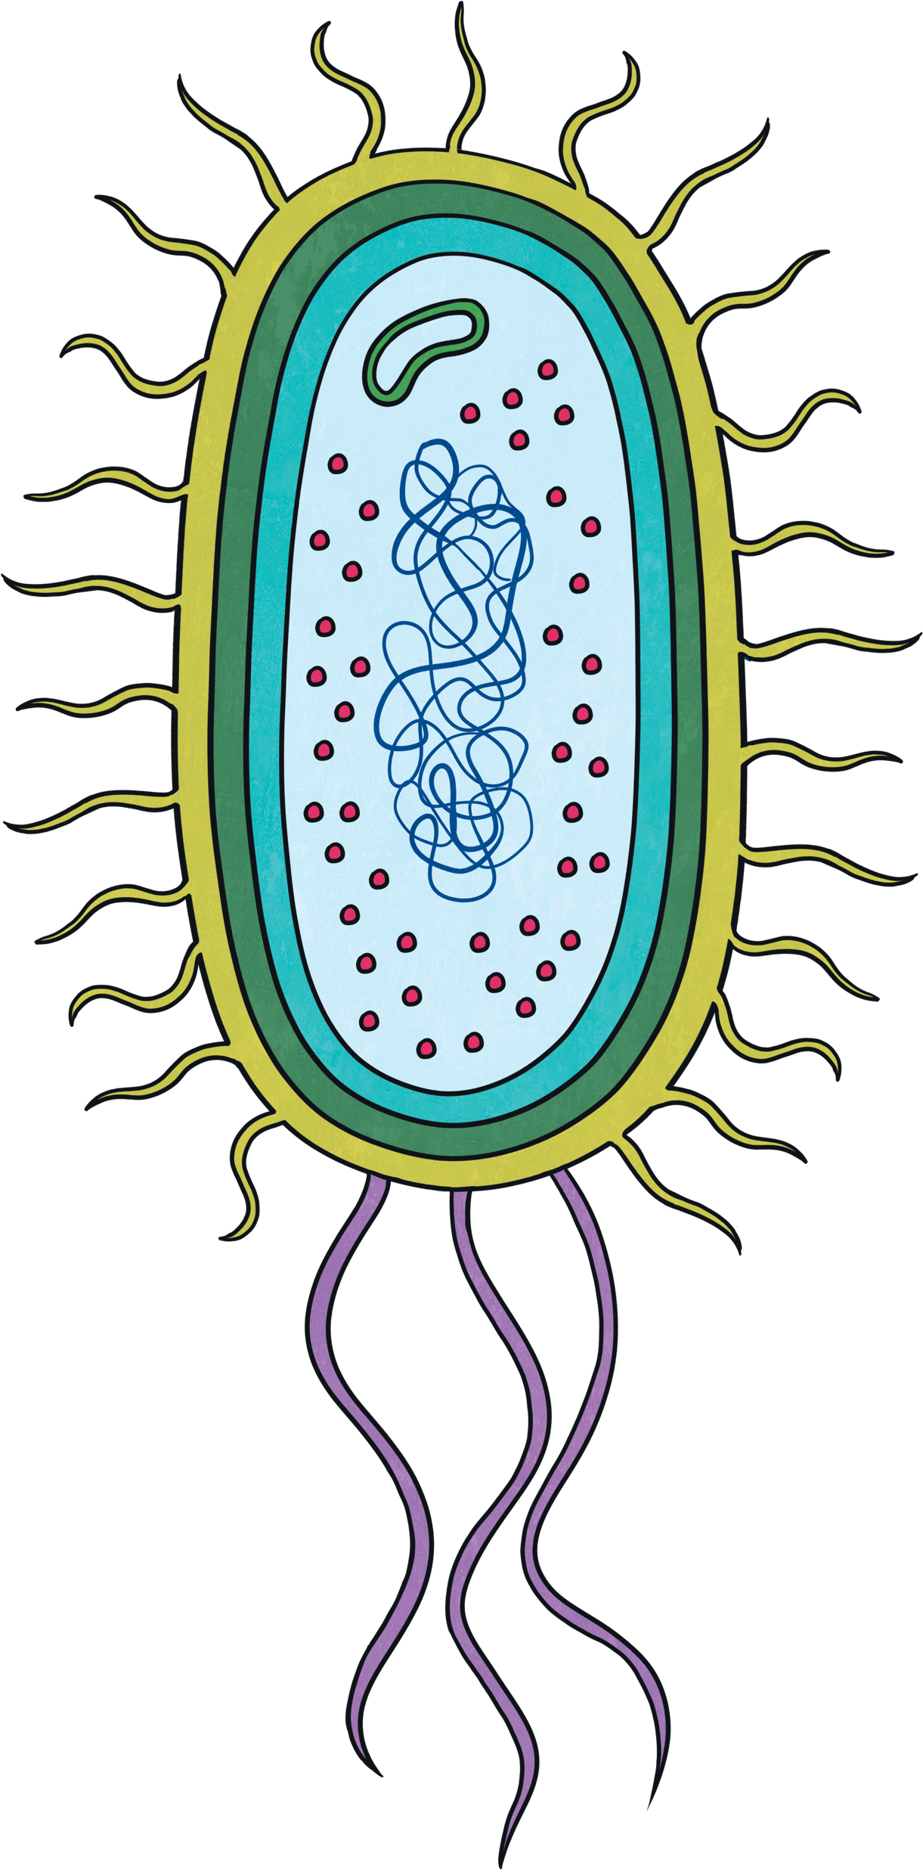
How can bacteria be good or bad for us?

Slide 6
Think of a food chain that includes a bear.

Slide 7

Think of different ways that seeds can disperse.

Slide 8
Can you name the parts of this plant?

Slide 9
What other forms can water take? How?

Slide 10
What does your heart do and how?

Slide 11
What do plants need to grow?

